Slide 1
Welcome to the expectation meeting for Barn Owls Class
The teacher in Barn Owls Class is Mrs. Aston.
We will sometimes have support from Mrs. Barber, Mrs. Gilpin and Mrs. Whittingham.

Slide 2
Springfields Behaviour Policy
The pupils at Springfields First School are taught how to behave by following the school rules:
Be Ready, Show Respect & Stay Safe.
Pupils are expected to:
Be safe by behaving in an orderly and self-controlled way
Show respect to members of staff and each other
Be ready to learn making it possible for other pupils to also learn
Be safe and quiet when moving around the school
Respect the school buildings and treat school property with respect
Be ready by wearing the correct uniform at all times
Show respect by accepting sanctions when given
Show respect by refraining from behaving in a way that brings the school into
disrepute, including when outside school or online
Where appropriate and reasonable, adjustments may be made to routines within the curriculum
to ensure all pupils can meet behavioural expectations in the curriculum.

Slide 3
Rewards and sanctions We have high expectations of behaviour at Springfields First School. The behaviour of the children is excellent.
When a pupil’s behaviour meets or goes above and beyond the expected behaviour standard, staff will recognise it with positive recognition and reward. Positive behaviour will be rewarded with:
Verbal praise and/or a class round of applause
A cheer and/or sticker
Team points
They are added to the class recognition board
Praise cards are sent home
Certificates during celebration assembly
Positions of responsibility (trusted with a specific job)
Whole-class rewards may include time to do a popular activity etc.

Slide 4
Rewards and sanctions
When a pupil’s behaviour falls below the standard that can reasonably be expected of them, staff will respond in order to restore a calm and safe learning environment, and to prevent recurrence of misbehaviour.
The school may use one or more of the following sanctions in response to unacceptable behaviour:
A verbal reprimand and reminder of the behaviour expected in school
Sending the pupil out of the class for a short period of time, to regain self -control or reflect on their actions
Expecting work to be completed at home, or at break or lunchtime
Missing of a break or lunchtime, pupil remains inside school or stands by the wall in the playground
Loss of privileges – for instance, the loss of a prized responsibility
Referring the pupil to a senior member of staff
Phone call home to parents
Agreeing a behaviour plan, with pupil and parents
Removal of the pupil from the classroom
Suspension
Permanent exclusions, in the most serious of circumstances

Slide 5
Timetable

Slide 6
Curriculum At Springfields First School, we believe that learning should be fun, purposeful and challenging. Through our creative curriculum we aim to equip each child with the skills that they need for lifelong learning.
Curriculum Overview – Long Term Plan
Year Two 2016-2017
 | Autumn | Spring |  | Summer
Cycle 1 2023-2024 | Time Travellers |  | Chocolate
Cycle 2 2024-2025 | The Romans |  | Going Green

Slide 7
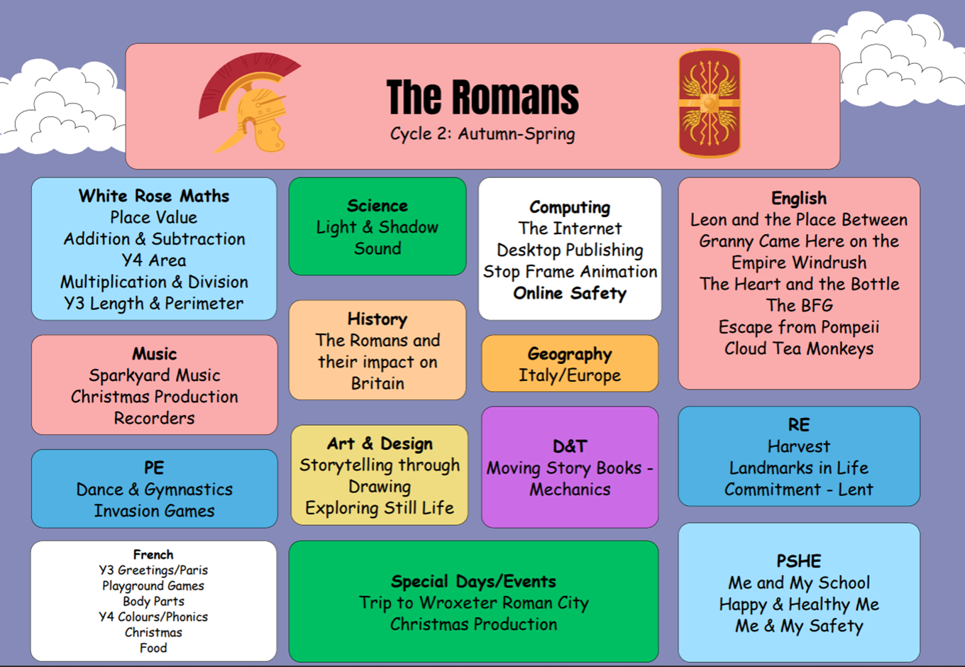
Topic Web

Slide 8
Homework We try to make homework relevant to the children and endeavour to give them a variety of activities that may challenge them with new learning or may practise skills already learnt in class.
Reading
Please could children bring their reading books
and diaries to school every day. Reading diaries
will be checked on the same day every week.
We expect reading diaries to be signed by a
parent/carer every time a child reads and before
books are changed.
Our main homework day will be Friday and it will be sent out in a homework book. Homework will include
the following:
Reading to an adult.
Spellings using Spelling Shed (Online)
Times tables using zones (Book) and TT Rockstars (Online)
There may also be the occasional piece of homework relating to our Topic.
Homework must be handed in no later than Thursday to give me time to mark it.
A little and often is the most effective way to learn spellings and maths facts, and let’s not forget…to develop reading skills.

Slide 9
Additional information
PE days are Thursday and Friday please ensure that children bring the appropriate school PE kit on Thursday and wear Fitness Friday clothes on Friday. (No non-uniform sportswear please).
Please provide a red hoodie and black tracksuit bottoms for your child to wear - where possible we will go outside for games lessons. Hair should be tied back, and no jewellery should be worn.
Please ensure that if home-time arrangements are different to normal that you let school know in writing or by phone.
Please encourage your child to take more responsibility for their school equipment now that they are KS2 – PE kits, homework, looking after school uniform etc. This independence will really benefit your child when they go to middle school.
Please be aware that Year 4 children will be required to take part in the statutory
Multiplication Tables Check in June and it is essential that they have rapid recall
of the times table facts, please practise with them regularly.
We will also be taking Year 4 pupils to Standon Bowers for a 2 nights residential.

Slide 10
Thank you for attending this meeting.
Any questions?
Please speak to us at the door or contact the school

